Slide 1
Serial IO

Slide 2
Basic concepts in serial IO
Interface requirements
  Address decoding, control signal generation
Alphanumeric codes
  ASCII, EBCDIC or any other coding
Transmission format
  Synch or asynch, simplex/duplex, rate of transmission
Error checks
  Parity, checksum, CRC
Data comm over telephone
  Voice:300Hz-3300Hz,Modem,fsk/psk/qpsk etc
Notes:
Checksum: used in block data transfer, adds all the bytes in the blk without carry, then 2’s complement of the sum and transmitted with the data as the last byte. Receiver adds all but the bytes, including the last byte; thus result sud be zero if no error in the block.
CRC: used when data transfer from/to a disk. A stream of data can b represented as a polynomial that is divided by a constant polynomial, the reminder is unique to the set of bits, is generated. This reminder is sent with the data blocks.

Slide 3
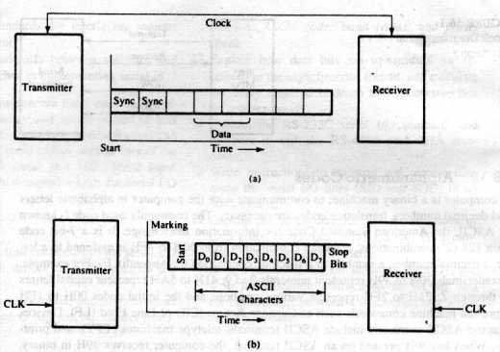
Syn and asycn transmission
a) Synch format b) asynch format

Slide 4
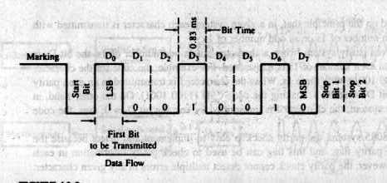
Serial bit format
Baud: number of signal changes per second; bits/second.
At 1200 baud; ASCII character I (49H) is presented
11 bits includes 1 start, 8 data and 2 stop bits
D₇ can be used as parity.

Slide 5
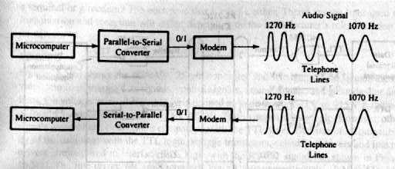
Data comm over telephone

Slide 6
Serial I/O standards
Commonly used to interface terminal, printer or modem.
Standard is a common specification that all the manufacturer have agreed upon.
  Assigment of pin position for signal, voltage levels, speed, length of cables and mechanical specs.
Current loop
  20mA or 60mA, signals relatively noise free and suitable over a long distance.
voltage level
  RS 232C, most commonly used method
  DTE, DCE

Slide 7
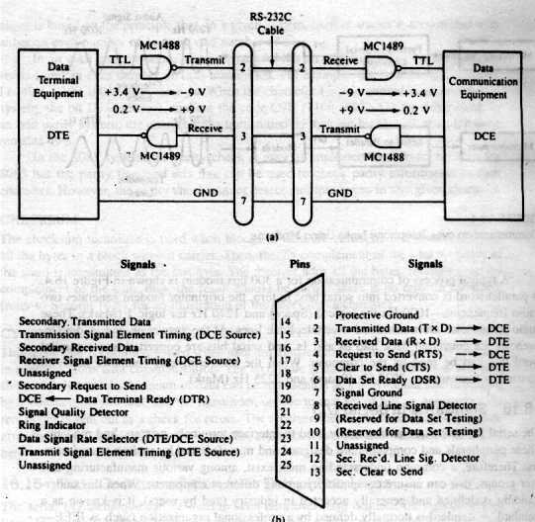
RS 232C
Speed 20Kbaud.
Distance 50 ft.
Logic zero: +3v to +15V
Logic one: -3v to -15V
Other signals are TTL.
25 pins

Slide 8
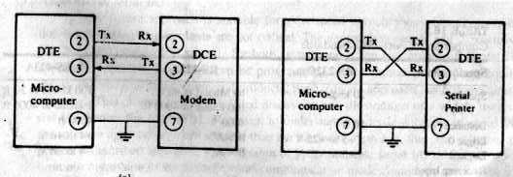
Minimum interface with RS232C
Usually printer is a DTE
Modem is a DCE

Slide 9
Other standard
Specs | RS232C | RS422A | RS423A
Speed | 20kbd | 10Mbd | 100kbd
Distance | 50ft | 4000ft | 4000ft
Logic 0 | 3 to 15 | B>A | 4 to 6V
Logic 1 | -3 to -15 | B<A | -4 to -6
Rcvr input volt | ±15V | ±7 | ±12

Slide 10
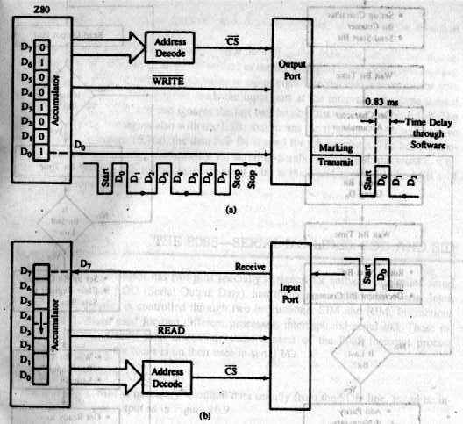
Software controlled Asycn serial I/O
Output start bit
Convert chara into serial stream with appr delay.
Add parity
Output stop bits.

Slide 11
transmit
rcv
Rd o/p port
Init bit cntr
Snd strt bit
N
Strt bit?
Y
Wait bit time
Wait ½ bit time
N
Bit still low?
Get chr into A
Y
o/p bit using D₀
Set bit cntr
Clr data rgstr
Wait bit time
Wait bit time
Rd i/p
Save bit
Rotate nxt bit to D₀.
Dcr bit cntr
Redy to rcv nxt bit
Dcr bit cntr
N
Last bit?
N
Last bit?
Y
Add parity
Snd stop bits
Chk parity
Wait for stop bits
return
return

Slide 12
8085 serial I/O lines
SOD (serial output data)
SID (serial input data)
D₃
D₇
D₆
D₅
D₄
D₂
D₁
D₀
SOD
SDE
X
1=enable
0=disable
For interrupts
MVI A, 80H ; Set D₇ =1
RAR ; set D₆ = 1, bring carry into D₇
SIM ; output D₇
D₇
D₆
D₅
D₄
D₃
D₂
D₁
D₀
SID
RIM ; reads a bit and put into D₇
Serial i/p data
For interrupts

Slide 13
Data trans using SOD
Send ascii char stored in B register.
SODATA: MVI C, OBH ;setup counter C to 11 bits
XRA A ; reset carry to 0
NXTBIT: MVI A, 80H ; set D₇ to 1 of accumltr
RAR ; Bring D₇ into D₆
SIM ; output D_{7;} start bit
CALL BITTIM ; wait for 1 bit time
STC ; set carry =1
MOV A,B ; place ASCII chr into ACC
RAR ; place ascii D₀ in the carry, and 1 in D₇
MOV B,A ;save ACC to B
DCR C ;one bit transmitted
JNZ NXTBIT ; if not all bits transmitted, go back
RET

Slide 14
(B) = 47H 0 1 0 0 0 1 1 1
CY D₇ D₆ D₅ D₄ D₃ D₂ D₁ D₀
XRA A 0 0 0 0 0 0 0 0 0
MVI A, 80H 0 1 0 0 0 0 0 0 0
RAR 0 0 1 0 0 0 0 0 0
SIM outputs 0 as stop bit
STC 1 0 1 0 0 0 0 0 0
MOV A,B 1 0 1 0 0 0 1 1 1
RAR 1 1 0 1 0 0 0 1 1
MOV B,A B= 1 0 1 0 0 0 1 1
DCR C C= 0 0 0 0 1 0 1 1
JNZ NXTBIT 1 1 0 0 0 0 0 0 0
RAR 0 1 1 0 0 0 0 0 0
.
When ascii D₇ is sent out, register B will have all 1s from D₀ to D₇. In the last two iterations logic 1s are sent out as stop bits.

Slide 15
Data reception using SID
SIDATA: RIM ; read input bit
RAL ; plc D₇ into CY
JC SIDATA ; if D₇ = 1, not a start bit, go bck and read again
CALL HALFBIT ; if D₇=0. strt bit. wait hafl bit time
MVI C, 09 ; bit cont = 9
NXTBIT: CALL BITTIME ; wait for one bit time
RIM ; read input bit
RAL ; save the bit D₇ to CY
DCR C ; one bit read
JZ RETURN ; if all bits are read return to main prog
MOV A,B ; plc the bits saved so far into acc from B
RAR ;plc bit saved in CY to D₇ and sft all bits by 1 position
MOV B,A ; save bits in B
JMP NXTBIT ; get nxt bit

Slide 16
HW controlled serial I/O
SW control has following requirements:
  An input port and an output port are req for interfacing.
  In transmission, MPU converts parallel data into serial bits.
  In reception, MPU converts bits from serial to parallel.
  Trans and rec must match the time delay.
In HW control has serial IO, all these features are incorporated in one chip, like 8251A (USART).

Slide 17
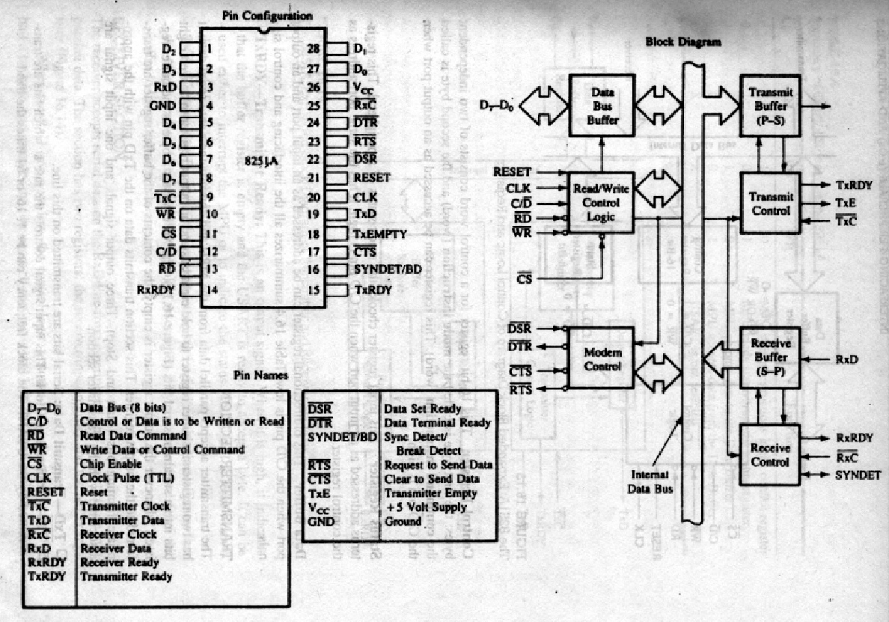
8251A
Chip select
Control/Data
Write
Read
Reset
Clock
Control register
  16 bit, mode instr, command instr
Status register
  It has the same add as the control register
Data buffer
  bidirectional
Notes:
When CS is low the USART is selected.
At high control/status register is addressed. At low data buffer is addressed
Connected to system clk. This does not contrl tr/rcv rate. Nedd to communication with microprocessor.

Slide 18
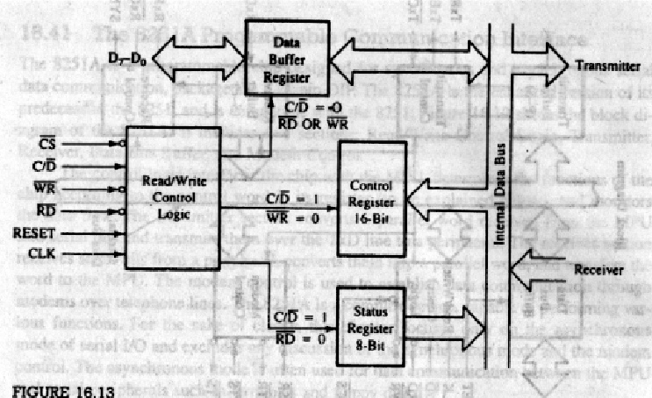
Control logic and registers
Control regstr
  16 bit: 2 independent bytes
  1st byte: mode instr
  2nd byte command inst
Status rgstr
  Chks the rdy ststs of peripheral
  Accessed when C/D’ is high
  Same port add as control regstr
Data buffer
  Bi directional
  At C/D’ is low
CS’ | C/D’ | RD’ | WR’ | Function
0 | 1 | 1 | 0 | MPU writes in the control register
0 | 1 | 0 | 1 | MPU reads status register
0 | 0 | 1 | 0 | MPU outputs data to data buffer
0 | 0 | 0 | 1 | MPU reads data from data buffer
1 | X | X | X | USART is not selected

Slide 19
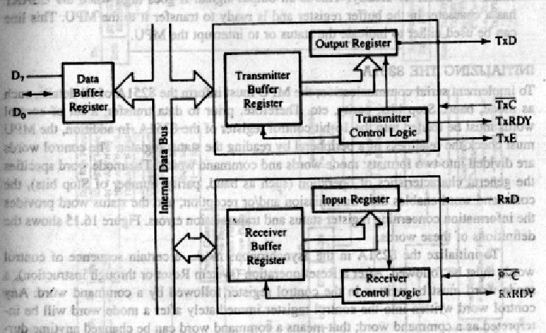
Blk diagram of Trn and Rcv section
Transmitter section
  TxD: serial bits are tran on this line.
  TxC: controls bit trans rate. Clk freq can be 1,16,64 times the baud.
  TxRDY: o/p signal,high indicates the trans buffer is empty and USRT ready to accept a byte. Signal is reset when data is loaded in the buffer.
  TxE: o/p signal High indicates that the O/P register is empty. Reset when a byte is trnasferd frm buffer to o/p rgstr.

Slide 20
Receiver section
RxD: bits are rcvd serially on this line
RxC: controls the rate at which bits are rcvd by USART. In asych mode, it can be 1, 16 or 64 times the baud.
RxRDY: it goes high when USART has a char on the input buffer register and ready to transfer it to MPU. Can be used either to indicate the status or to interrupt MPU.

Slide 21
Initializing 8251A
Mode, baud, stop bits, parity, etc.
Control word: a) mode word b) command word
After a reset operation, a mode word must be written in the control register followed by a command word. Command word can be changed at any time during operation, but mode can only be changed only after a reset operation. It can be reset using internal reset bit (D₆) in the command word.

Slide 22
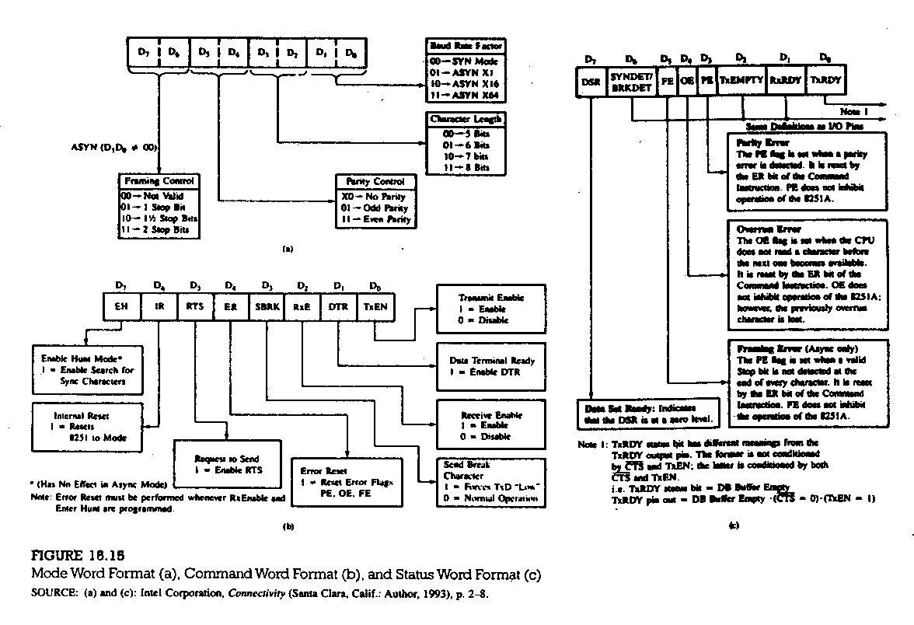

Slide 23
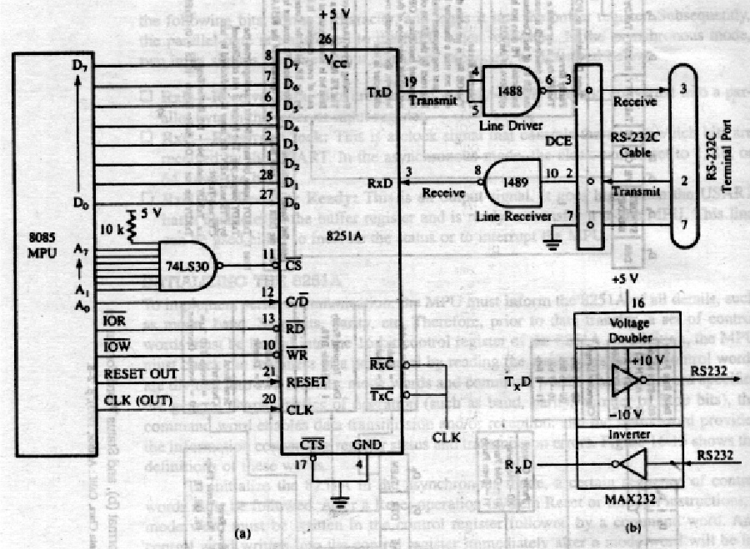
Interfacing RS232 terminal using 8251A
TxC is 153.6 kHz.
Asycn mode with 9600 baud
Character length = 7 bits, two stop bits
No parity check.
Port add
  Data register: FEh
  Control/status register: FFh

Slide 24
Mode word:
D₇ D₆ D₅ D₄ D₃ D₂ D₁ D₀
1
1
0
0
1
0
1
0
=CAh
No parity
Baud= TxC/16=153.6k/16 = 9600
Stop bits
7 bits chr
Command word (asynch mode):
D₇ D₆ D₅ D₄ D₃ D₂ D₁ D₀
X
0
X
1
X
0
X
1
=11h
Prvnts
Intrnal
reset
Err Rst
Rcv Disbl
Tr Enbl
Status word:
D₇ D₆ D₅ D₄ D₃ D₂ D₁ D₀
X
X
X
X
X
X
X
1
=01h
Tr rdy

Slide 25
Initialization intruction:
SETUP: MVI A, CAh ; load mode word
OUT FFh ; write mode word to control rgstr
MVI A, 11h ; load command word
OUT FFh ; enable trnsmitter
STATUS: IN FFh ; read stats word
ANI 01h ; mask all bits except D₀
JZ STATUS ; if D₀ = 0, Tr buffer is full, go back and wait

